Slide 1
Quiz presentation
Made by Mike Wazowski

Slide 2
Customer requirements
The client wanted us to make a game, and the theme and structure of the game was left to the team to decide. The basic requirement was that the game had to be functional.

Slide 3
Introducing the crew
Zsiros Máté Ferenc:
Place of birth: Barcelona
Place of residence: Palotás
Date of birth: 2005. 05. 15.
Phone number: 06-30-723-5679
Positions: programmer, manager

Slide 4
Introducing the crew
Tóth Bence:
Place of birth: Tahitótfalu
Place of residence: Budapest
Date of birth: 2003. 06. 25.
Phone number: 06-70-256-4173
Positions: programmer, presenter

Slide 5
Introducing the crew
Kovács Zétény:
Place of birth: Budapest
Place of residence: Budapest
Date of birth: 2004. 07. 08.
Phone number: 06-30-150-7069
Positions: programmer, English-speaking presenter

Slide 6
Introducing the crew
Kiss Benedek:
Place of birth: Budapest
Place of residence: Budapest
Date of birth: 2004. 09. 06.
Phone number: +7 495 697-03-49
Positions: programmer, wingman

Slide 7
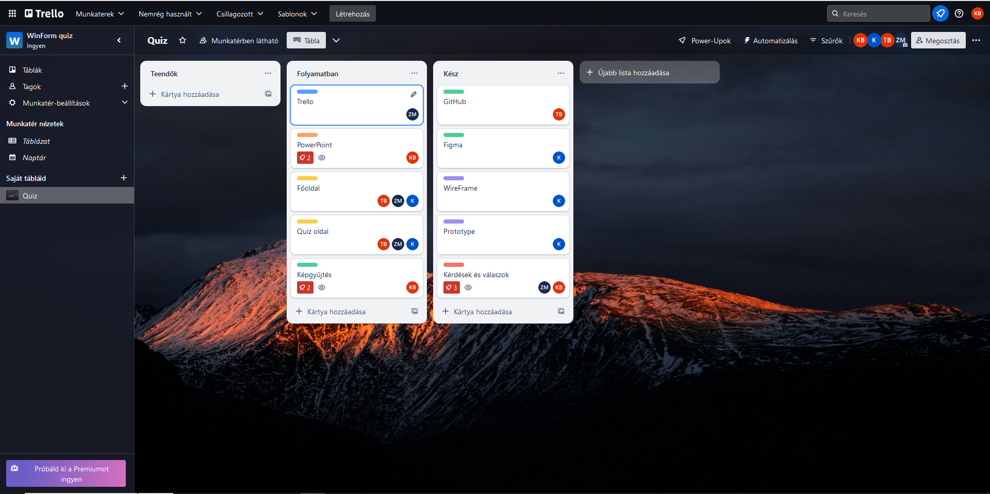
Resources
Trello:
In the Trello interface, we have divided the tasks and whether each task is in progress or finished.

Slide 8
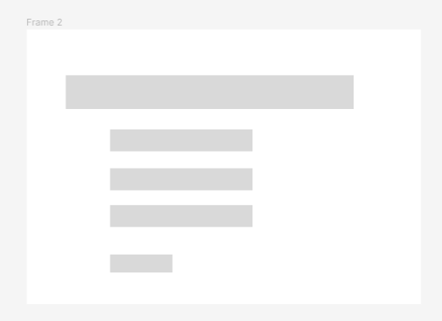
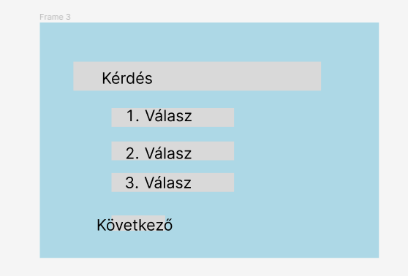
Resources
Picture of the wireframe
Figma:
We designed the prototype and its wireframe on the Figma site. Several people can work on this interface at the same time.

Slide 9
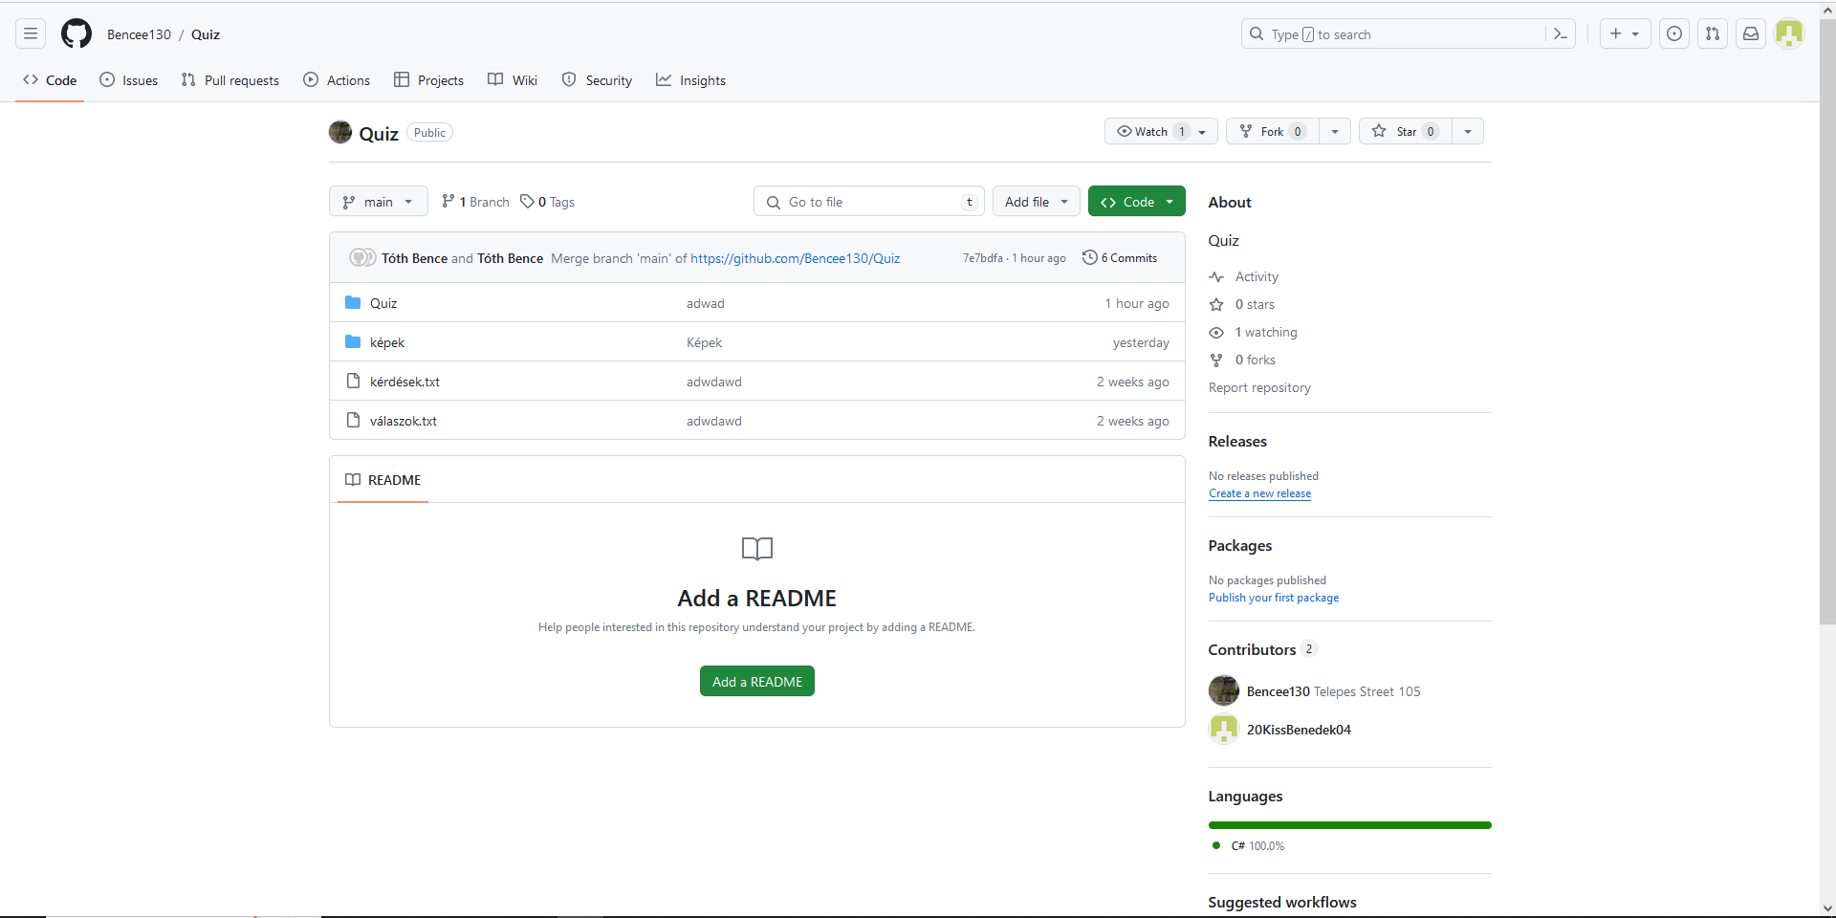
Github
We shared the files on Github. If the situation requires that someone is absent, you can share important things from home.

Slide 10
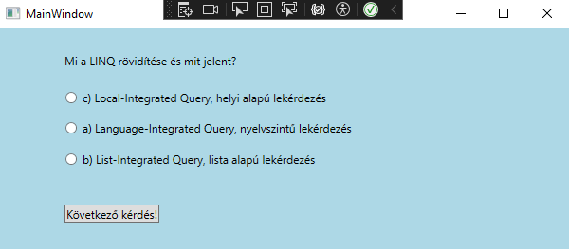
Picture of the page

Slide 11
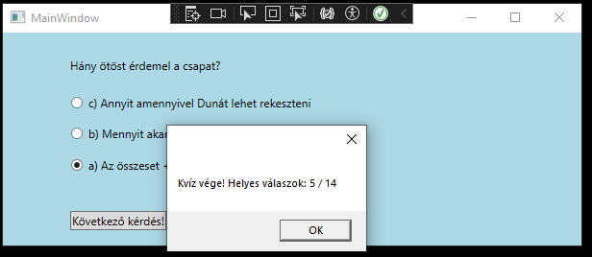
Picture of the page

Slide 12
Thank you for your attention!

